Slide 1





How do bacteria adapt to salinity?
Large-scale phylogenomics of aquatic bacteria reveal molecular mechanisms for adaptation to salinity
Krzysztof T Jurdzinski, Maliheh Mehrshad, Luis Fernando Delgado, Ziling Deng, Stefan Bertilsson, Anders F Andersson

Slide 2
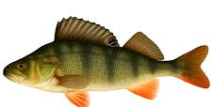
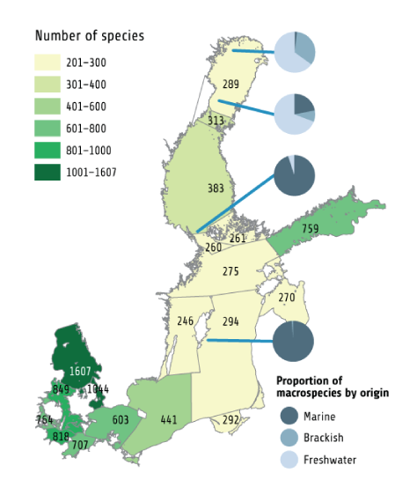
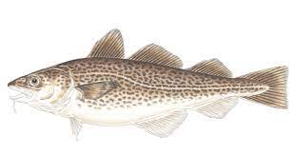
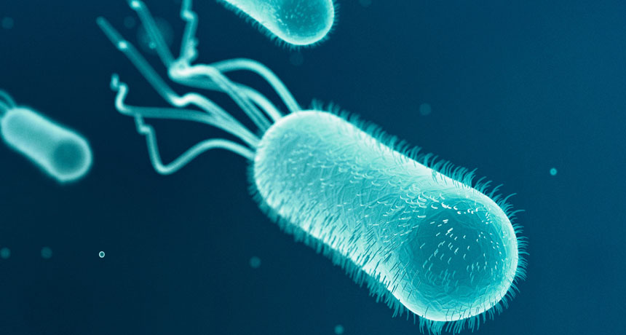
Adaptation to salinity in the Baltic Sea
adaptation
Freshwater
species
Macroorganisms
Local freshwater & marine species adapted to brackish conditions after the Baltic Sea formed
Marine
species
What about microbes?
adaptation
?
HELCOM, Bergström et al. 2018
Notes:
The baltic sea is a also comapred to the open oceans a very young ecoystem.
It was covered by ice during the last ice age and brackish conditions started to establish about 8000 years ago.
For macroorgansisms, the sea is mainly inhabited by freshwater and marine species that have managed to adapt to the brackish condittions after the sea was formed.
The brackish conditons are harsch for both freshwater and marine organisms, so therefor the sea is relatively species poor.
How microbes have adapted to this environment is one of the things we study.

Slide 3
Why study bacterial adaptation to different water salinity levels?
Salinity is the major driving force of microbial community composition globally (Lozupone and Knight 2007).
Salinity levels are changing due to human activity (climate change, freshwater input).
Ionic concentrations and osmotic pressure govern basic physiological and biochemical processes.
It can guide enzyme discovery (unculturable bacteria, metagenomic studies).

Slide 4
Workflow

Slide 5
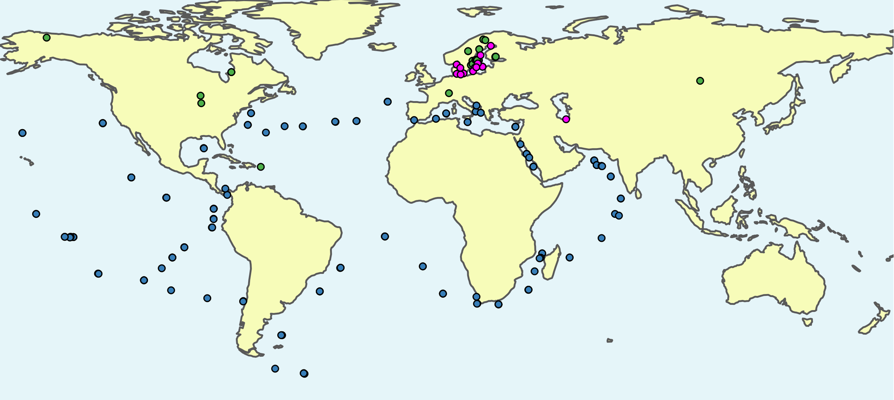
We collected publicly available freshwater, brackish and marine metagenome-assembled genomes (MAGs)
Linz et al. (2018)
Buck et al. (2021)
Cabello-Yeves et.al. (2018)
Alneberg et al. (2020)
Mehrshad et al. (2016)
Tully et al. (2018)
Delmont et al. (2017)
3575 ~species
11,276
MAGs
≥75% completeness
≤5% contamination
Metagenomes: 416 freshwater, 126 brackish, 243 marine

Slide 6
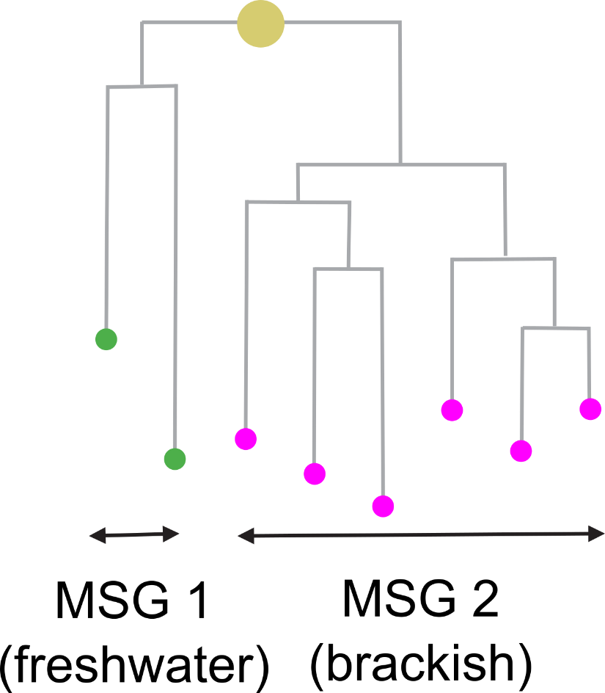
We reconstructed phylogeny and analysed cross-biome transitions
Phylogeny reconstruction
Transitions as pairs of monobiomic sister groups (MSGs)
Identify
ANI analysis
Population genomics

Slide 7

We analyzed evolutionary dynamics and genomic changes across transitions
Evolutionary dynamics
Inferred proteomes
Gained/lost genes
Frequency
Direction
Timing
Isoelectric point (pI) distribution
and amino acid composition
Presence / absence of
groups

Slide 8
Results

Slide 9
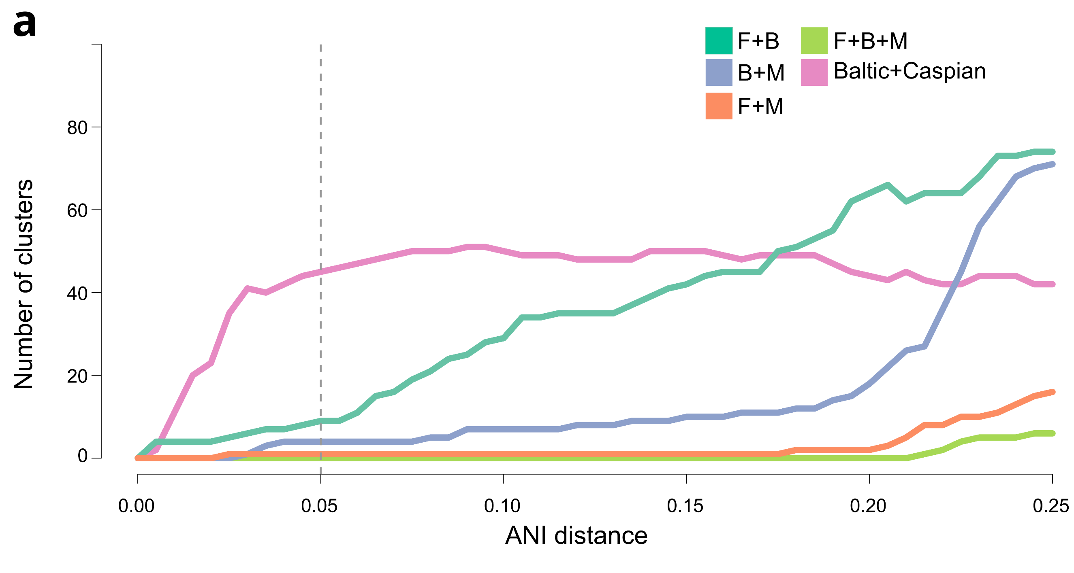
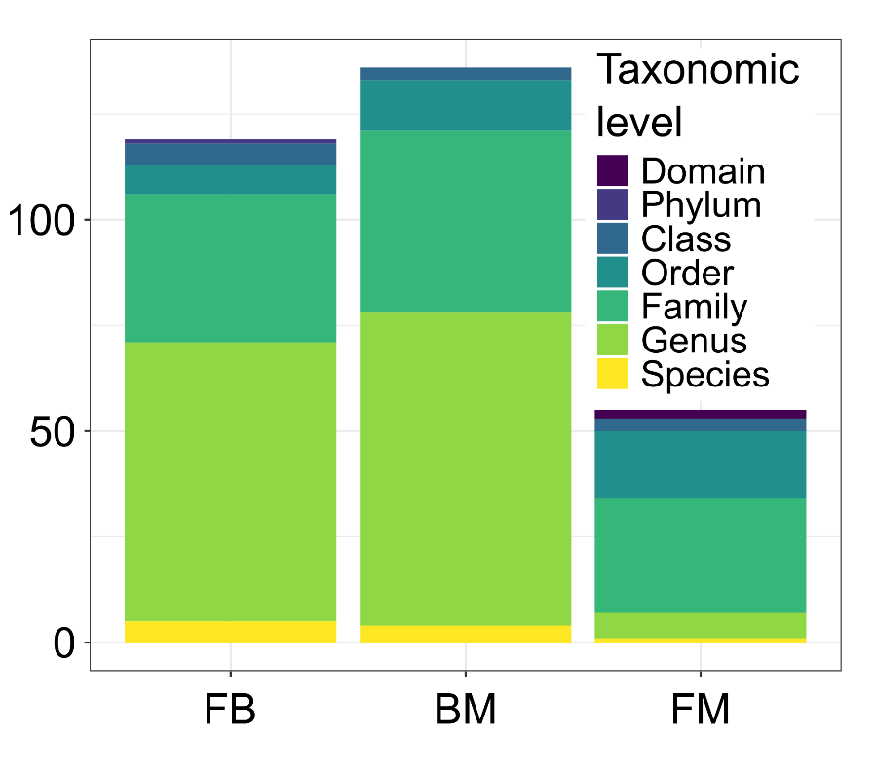
Species-level separation between biomes
3561 95% ANI genome clusters
2063 freshwater, 485 brackish, and 999 marine; 9 FB, 4 BM, and 1 FM
Brackish: 300 Batlic, 141 Caspian, 44 common
Species-level separation between biomes

Slide 10
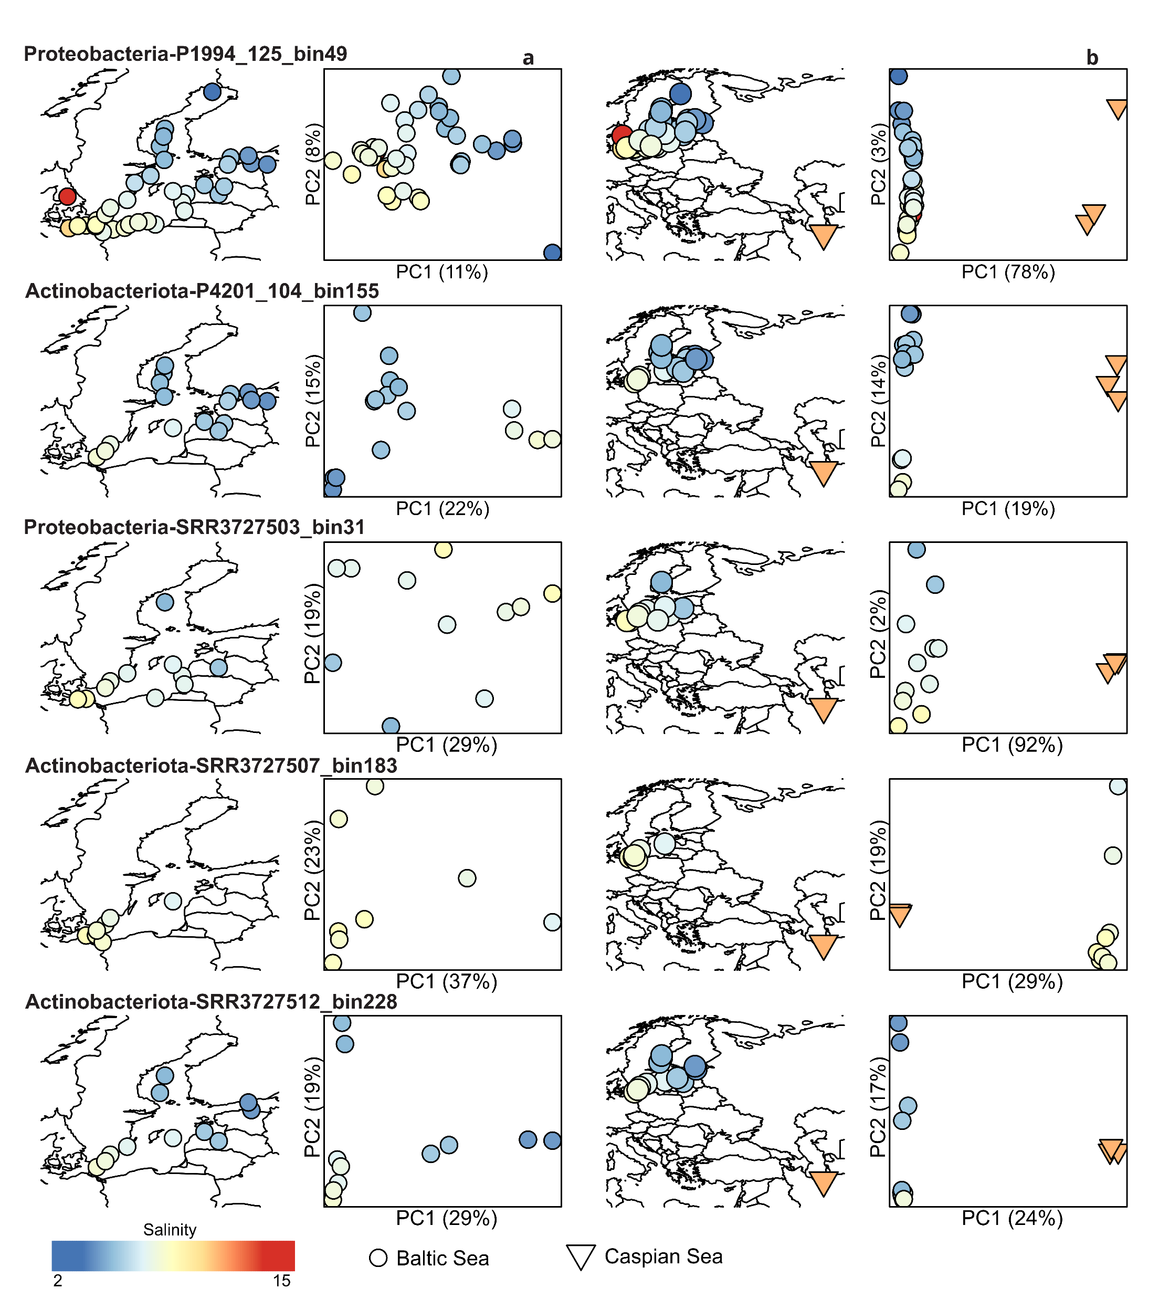
Population genomics: stronger effects of geographic isolation than salinity
Geographic micro diversity within brackish biome

Slide 11
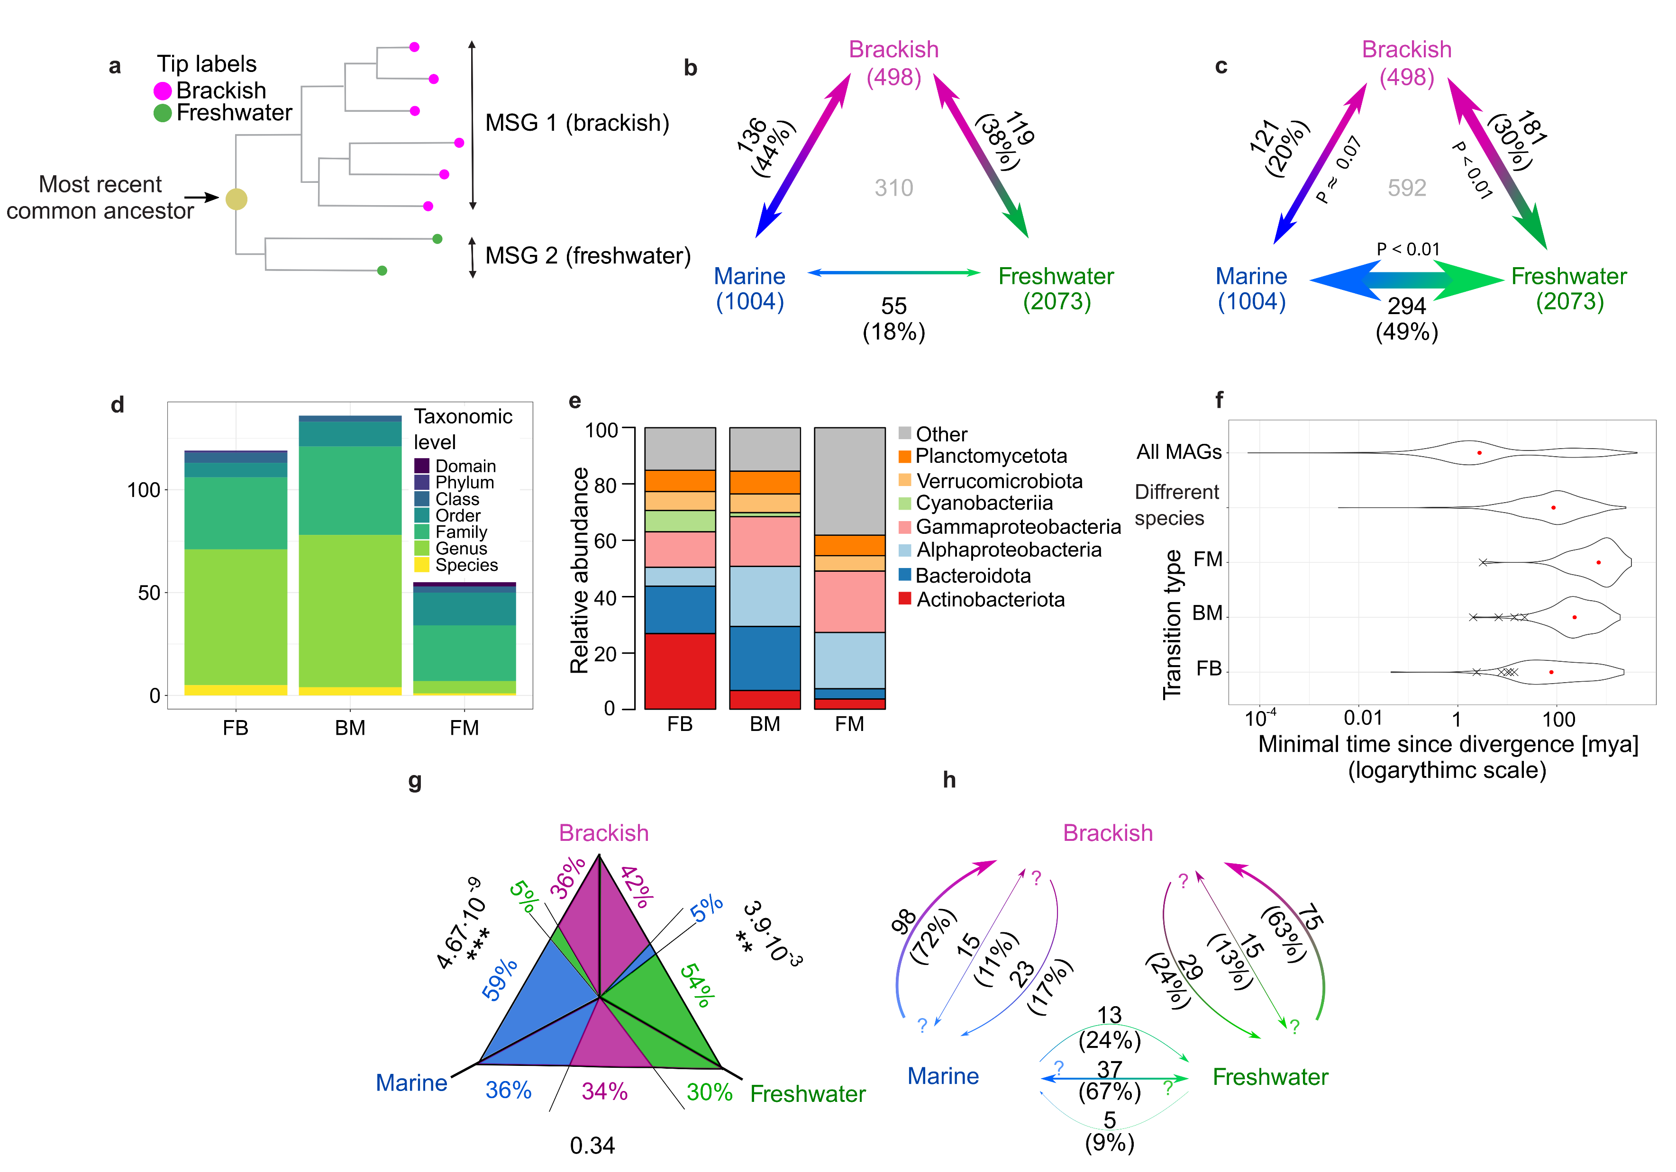
Cross-biome transitions were rare
Observed
Expected

Slide 12
We identified no recent cross-biome transitions
Age of: Baltic Sea Caspian Sea
8 kya
2-3 mya
Niches filled by migration not adaptation

Slide 13


Transitions happened more often into than out of brackish waters

Slide 14
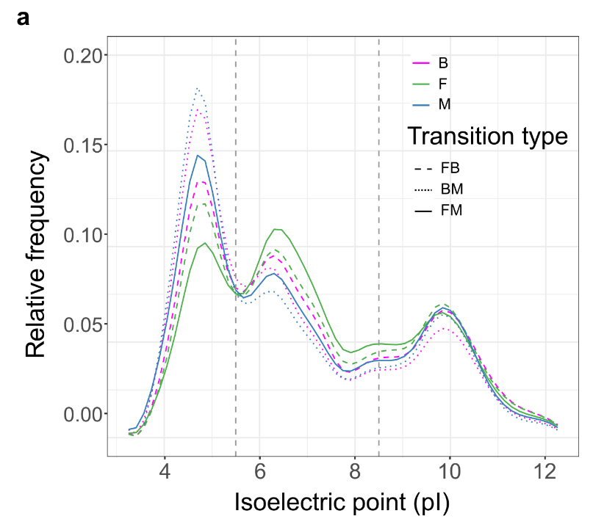
Distribution of isoelectric point (pI) within inferred proteomes shifts after transitions
More neutral proteins in lower salinity – all transitions
More acidic proteins in higher salinity – FB and FM
Inspired by Cabello-Yeves and Rodriguez-Valera (2019)
Solubility of neutral proteins?

Slide 15
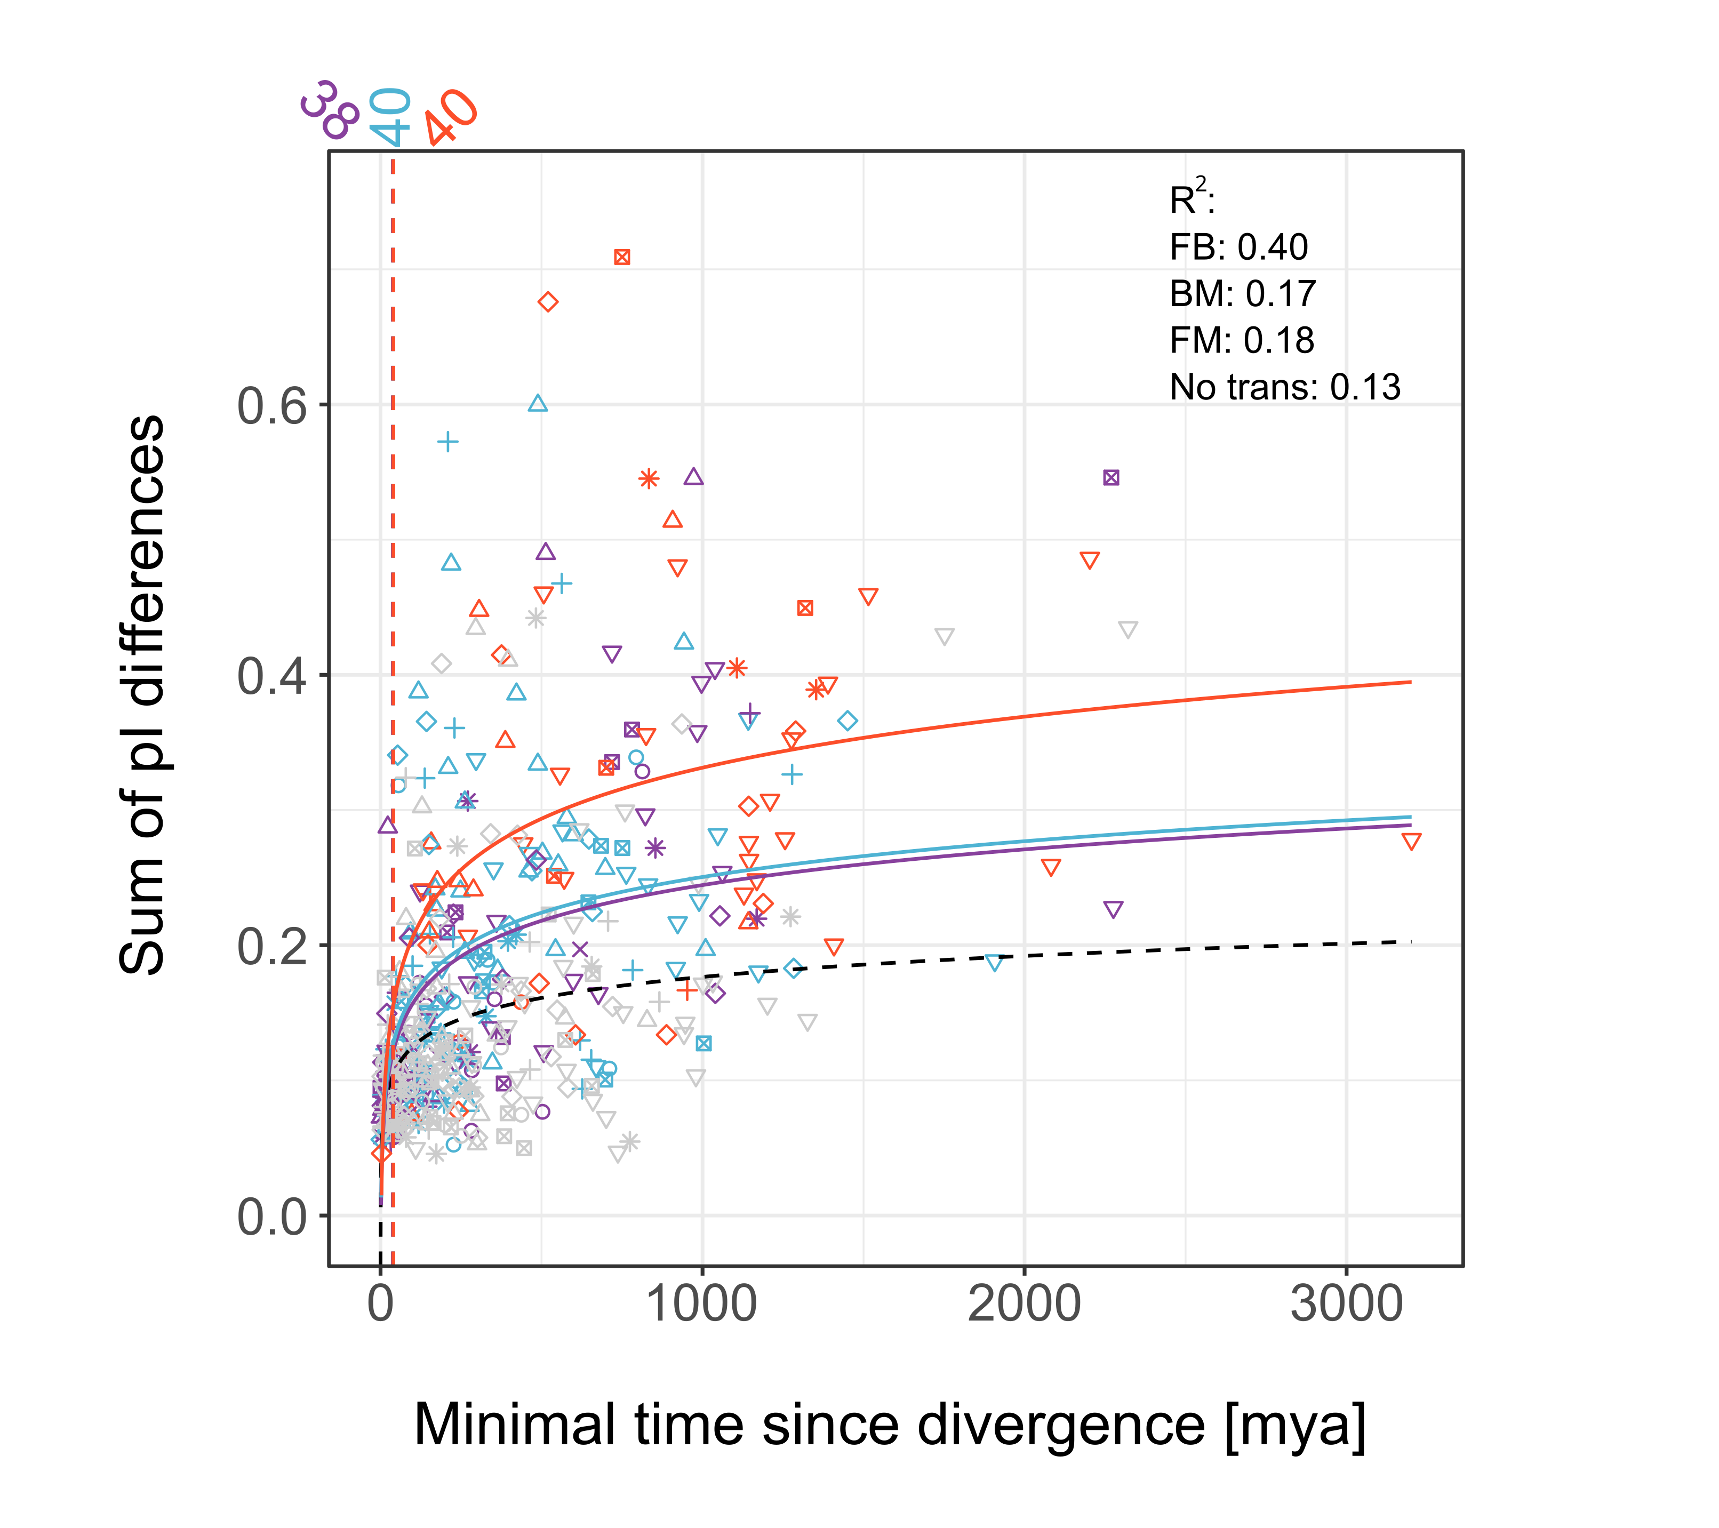
The shift in pI takes considerable amounts of time
After corrections:
44 my for FM
86 for BM
181 for FB
Hard to overcome barier – sets separation?

Slide 16

Changes in the usage of acidic amino acids underlie the shift in pI

Slide 17
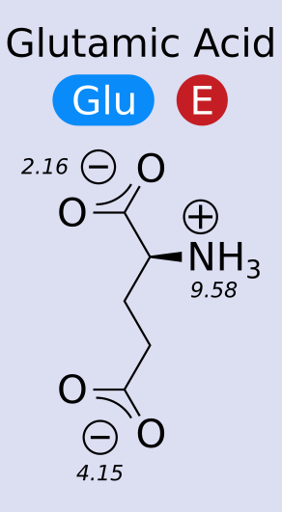
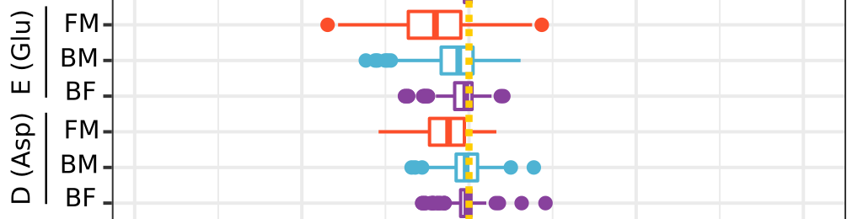
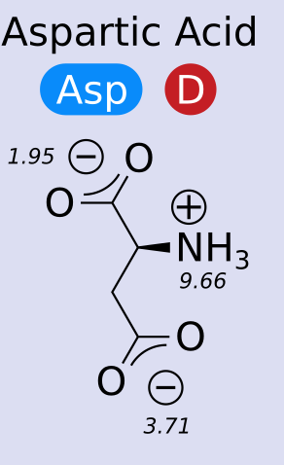
Glutamate – the key (acidic) amino acid
Why?

Slide 18
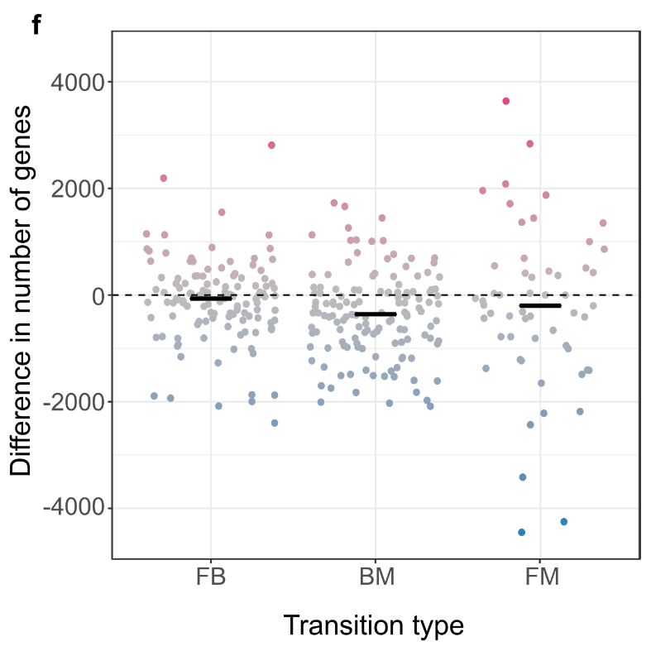
Brackish genomes contain more genes than their marine counterparts
Different MGE exposure
Observed
Expected
Biome separation sets recombination barier?

Slide 19
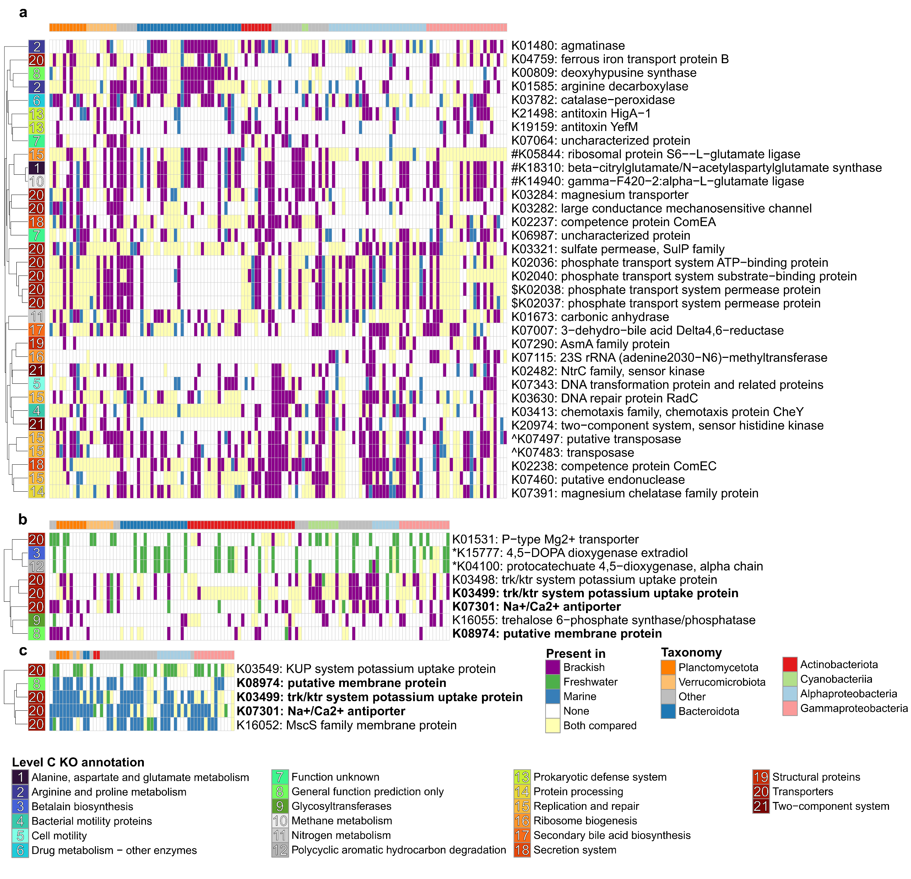
Transporters and metabolism differ between brackish and freshwater MAGs

Slide 20
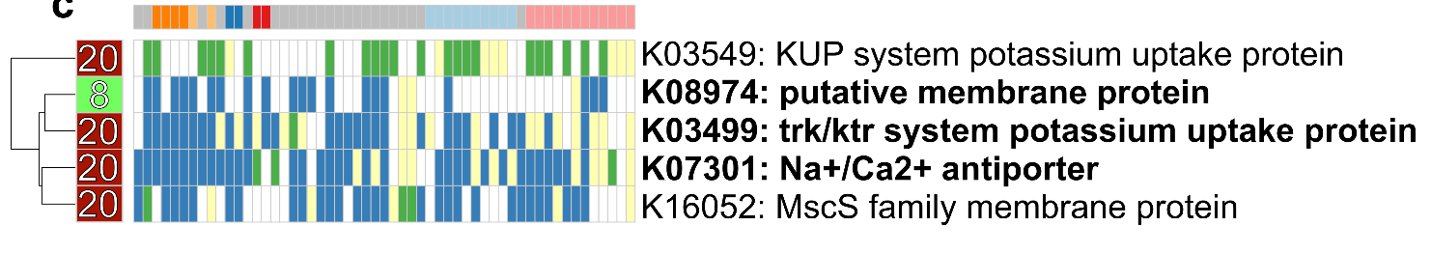
Specific transporters are crucial for transition between marine and freshwater MAGs

Slide 21
Transporters, phenotypic and genomic plasticity dominate gene content differences between brackish and marine MAGs

Slide 22

Conclusions
Different species inhabit different biomes.
Cross-biome transitions are rare, ancient (mya) and more often into than out of the brackish biome.
Cross-biome transitions lead to wide-scale changes in proteome composition…
…and gain or loss of specific gene functions.
Large-scale phylogenomics of aquatic bacteria reveal molecular mechanisms for adaptation to salinity
Krzysztof T Jurdzinski, Maliheh Mehrshad, Luis Fernando Delgado, Ziling Deng, Stefan Bertilsson, Anders F Andersson

